Slide 1
Update m4QI Uganda
James Bon Tempo, Jhpiego
Pamela Riley, Abt Associates
April 26, 2012

Slide 2
Recap m4QI Background
Problem statement: need for a cost-effective means of reinforcing training of field staff
  Face-to-face is expensive, pulls providers away from clients, skills forgotten over time
  Solution: SMS assessments and reminders
  Leverages ubiquitous access to mobile phones
  SMS quizzes participatory, interaction reinforces learning
  Identifies gaps in knowledge for follow-up
March 2011: presented who, what, how, where

Slide 3
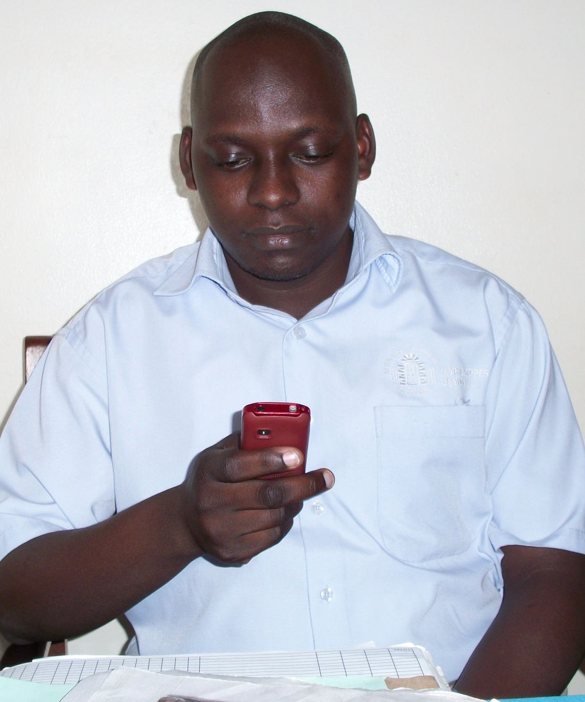
m4QI Pilot Overview
Scope:
34 FP providers at 6 MSI Uganda locations
Intervention:
Sent daily messages for eight weeks on 4 topics
Qualitative process evaluation:
User experience
Implementation

Slide 4
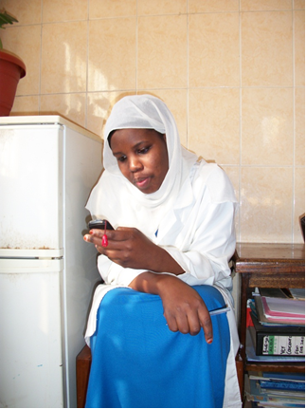
m4QI Results
86% messages were successfully delivered but pilot experienced technical problems
  Low response rate (19%) attributed to intermittent system failure, formatting errors
Assessment questions identified knowledge gaps with actionable data
Self-reported behavior change for all indicators

Slide 5
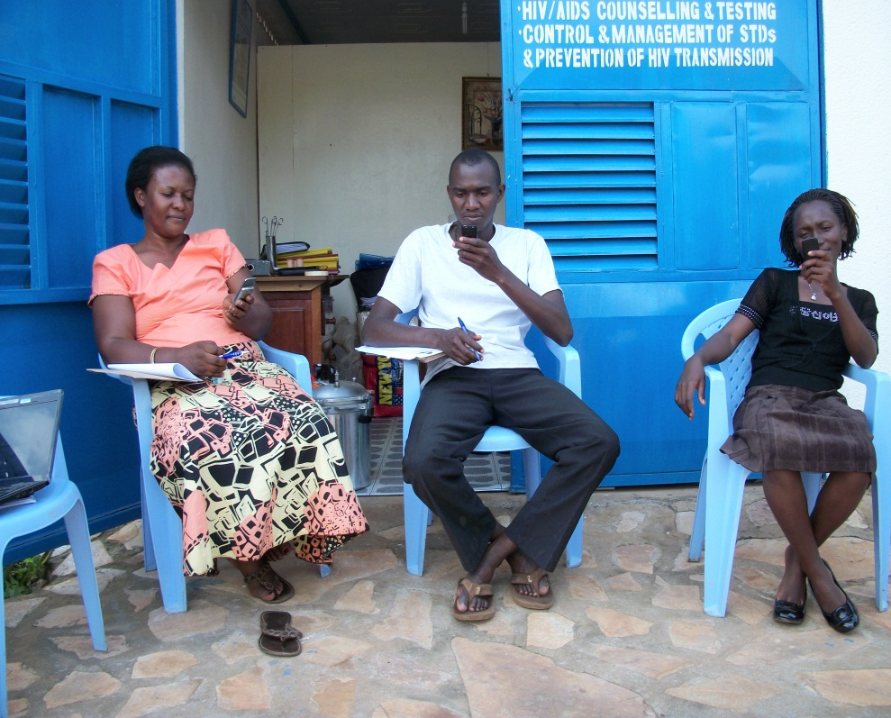
m4QI User Experience
“I gave a wrong response to one question and I received instant reply/feedback. The feedback was very clear”. Transport Assistant
“We used to have boxes which were not puncture proof but now we have ones which are puncture proof”. Clinical Officer
a
“People are more serious with hand washing. The project remained as a constant motivator of hand washing”. Outreach Manager

Slide 6
Cross-cutting issue: Working with global technology partners
FrontlineSMS evolving as pilot evolved
  New versions of core platform in development
  New staff, processes, policies for QA
  Needed resources for incorporating and supporting Learn within FrontlineSMS family of applications
Current status
  Revised code for FrontlineSMS:Learn in alpha testing
  Target for public launch May 2012
  MSU planning to roll out nationally: staff, social franchisees, outreach partners

Slide 7
jbontempo@jhpiego.net pamela_riley@abtassoc.com
www.shopsproject.org

